Slide 1
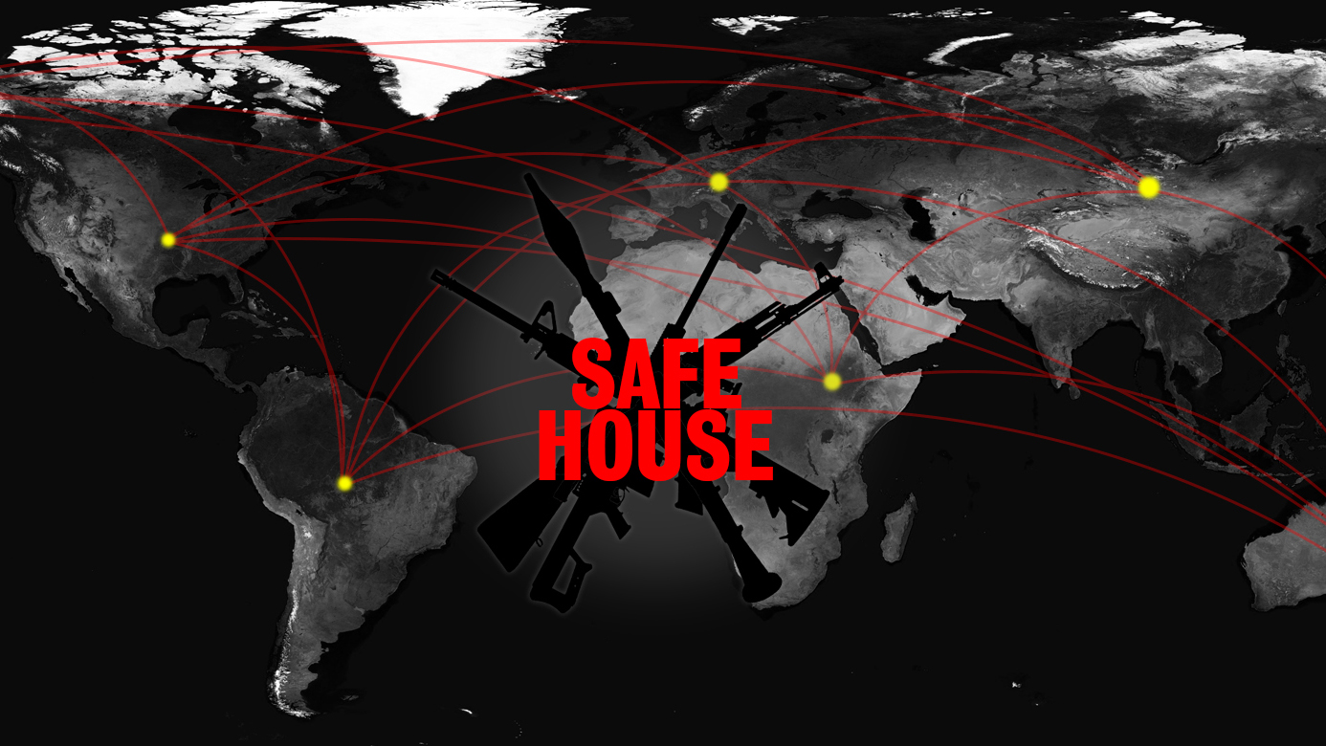

Slide 2

TEAM MEMBERS
Kameron Spivey | Zachary Blanton | Kalen Plummer
Team Leader and Co-Programmer | Lead Programmer | Real Time Graphics and Design

Slide 3

CUSTOMER
Tony Elam
 | CS Lecturer Board game enthusiast Owns thousands of board games

Slide 4
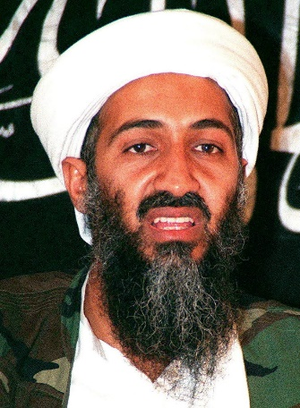
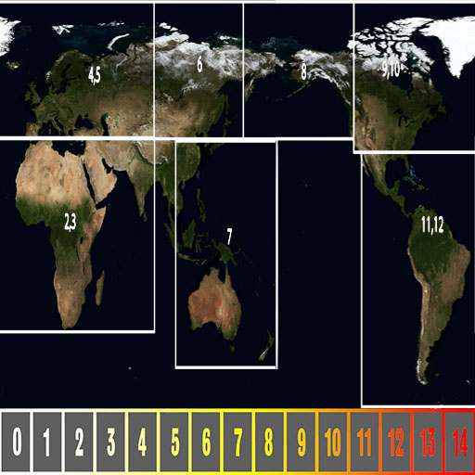
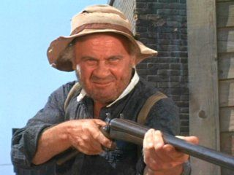

ABOUT SAFEHOUSE
Board game created by Tony Elam
From 3-8 players
You can play as a Terrorist, Counter Terrorist, or Neutral
Each character has a different way in which they can win
The goal is to figure out who they other players are and strategically work to fulfill your personal win condition
Terrorist (Osama)
Neutral (Billy Bob Badass)
Counter Terrorist (CIA Charlie)
Game Board

Slide 5


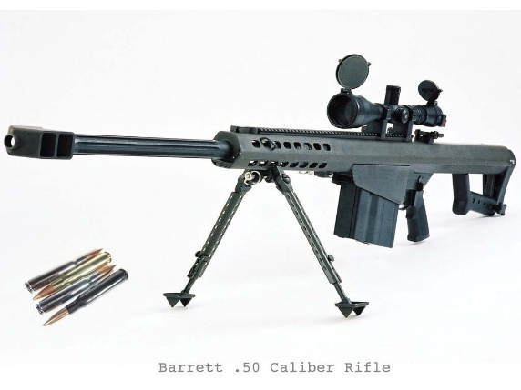
ABOUT SAFEHOUSE
As the game progresses you will gain equipment you can use
You will also have the opportunity to investigate other players as well as use one time actions
Multiple players can win
Equipment
Investigation
One Time Action

Slide 6
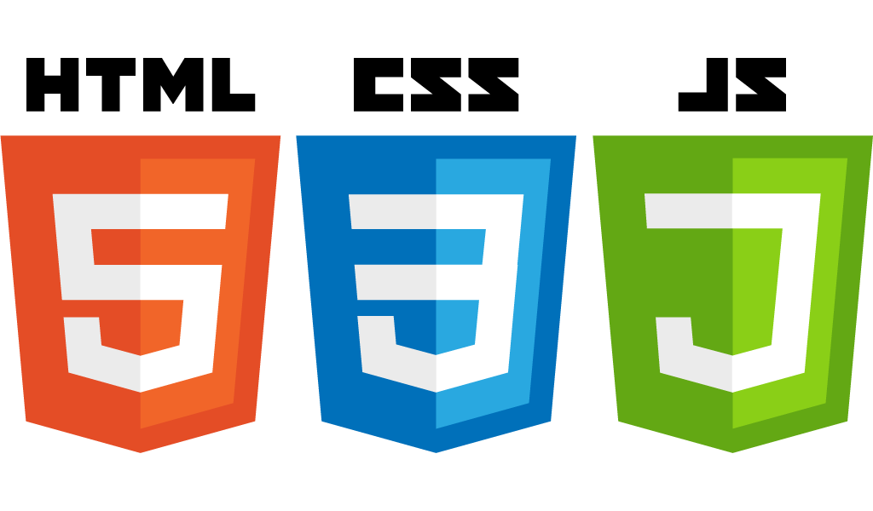
PROBLEMS SOLUTIONS
1. An understandable way to implement pass and play multiplayer |  | 1. Stated Pass and Play
2. The most efficient way to implement the game |  | 2. Javascript, HTML5, CSS, THREE.js
3. Finding a way to make javascript work for our game engine |  | 3. A State Machine
4. The scale of the project vs. the time we had |  | 4. Prioritize game play above aesthetics

Slide 7
INITIAL DESIRES
Initial Assumptions | Initial Customer Wishes
An interesting task requiring dedication A great way to learn a popular game engine Game logic will be tedious but not difficult | Make a challenging and thought provoking game Take his board game and turn it into a fully playable digital version Implement game customization and A.I.

Slide 8
WHAT WE KNOW NOW
Requiring Dedication was a DRASTIC UNDERSTATEMENT
Game logic was rather complex
Lots of moving pieces
Picture of a bunch of pieces on the board

Slide 9
EVOLUTION OF SAFEHOUSE
Develop intuitive solutions to meet the customers expectations
A game engine was not feasible
Implementation of pass and play through a state machine
Picture highlighting log

Slide 10
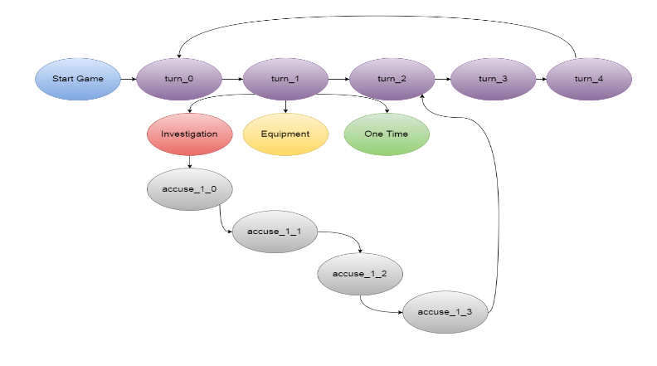
STATE MACHINE

Slide 11
EVOLUTION OF SPECS
Some game aspects were changed
Decide to remove stacking of effects
Force players to play a card immediately instead of holding it
I think we should remove this

Slide 12
FUTURE ENHANCEMENTS
TONS of potential for future enhancement
Customization
Cross Platform network multiplayer
A.I. Implementation
Other applications
Fake pictures of customization

Slide 13

LESSONS LEARNED
Time Management
Don’t be afraid to step out of your comfort zone
Game programming is much more than what everyone comes to CS wanting to do
Remove Distractions and work towards the goal

Slide 14
QUESTIONS?

